Slide 1
RentHelpMN and the Eviction Off-Ramp
(Oct. 2021)
Presented by Housing Justice Center

Slide 2
Who are we?
Housing Justice Center is a nonprofit public interest advocacy and legal organization whose mission is to preserve, protect, and expand affordable housing for low-income individuals and families.
We believe that housing is a human right, and we use tools such as legal advocacy, policy advocacy, education and research to bolster community-articulated strategies for housing justice.
Contact Us
General Inquiries: (612) 807-1139 or info@hjcmn.org
RentHelpMN: 1 (800) 403-0476

Slide 3
Today's Presenter: Max Tsai
Contact Me
RentHelpMN related issues: 1 (800) 403-0476
Email: mtsai@hjcmn.org

Slide 4
Agenda
RentHelpMN Application Overview
Prequalification Letter/Application Statuses
Appeals/What to do After Denial
Common Tech Issue: Username/Password Recovery
FAQ
Q&A

Slide 5
RentHelpMN Basics
What is RentHelpMN?
  COVID-19 Emergency Rental Assistance Program distributed by Minnesota Housing
Who is eligible?
  Be a low-income Minnesota renter
  Be eligible for unemployment benefits OR have experienced financial hardship directly or indirectly due to the coronavirus outbreak
  Can demonstrate a risk of experiencing homelessness or housing instability

Slide 6
RentHelpMN Basics Cont.
What is low-income for RentHelpMN?
  Renters must be at or below 80% of Area Median Income
  Ramsey County AMI
    1 Person Household - $55,950
    2 Person Household – $63,950
    3 Person Household - $71,950
    4 Person Household - $79,900
Documentation for Income Certification
  Form of ID for head of household – Must also document that they rent
  Documentation of household income for all adults – Tax and pay documents, employer certification.
  Most things can be self-certified to if documents are not available

Slide 7
RentHelpMN Basics Cont.
What types of rental properties are eligible for assistance?
  Apartments
  Single-family homes
  Rented manufactured homes
  Hotels, motel stays if they are the renter’s primary residence
  Other informal lease agreements subject to review by the program
What costs will be covered?
  Assistance for up to 12 months of back rent (15 mo. Total of assistance)
  IF YOU HAVE BACK RENT – utility costs (minus phone or internet) + up to 3 months of forward rent. Late fees are covered as well.
  Do not apply IF 1) only requesting forward rent OR 2) only requesting utilities
    Applications for these will be opened up at a later date (TBD).

Slide 8
How do I apply?
Option 1: Apply online at RentHelpMN.org or by calling 2-1-1
Option 2: Apply by paper via mail or fax
  Include cover letter or cover page (if faxing)

Slide 9
A (Simplified) Overview of the RentHelpMN Application
Steps in Submitting RentHelpMN Online Application
  Step 1: Look at the RentHelpMN "Renters Checklist".
    IMPORTANT: To the extent practicable, gather the information and documents required BEFORE beginning the online application.
    NOTE: Most information can be self-attested to if necessary
  Step 2: Go to apply.renthelpmn.org and Complete the Prescreening
  Step 3: Fill out the RentHelpMN Online Application
  Step 4: Submit the RentHelpMN Online Application

Slide 10
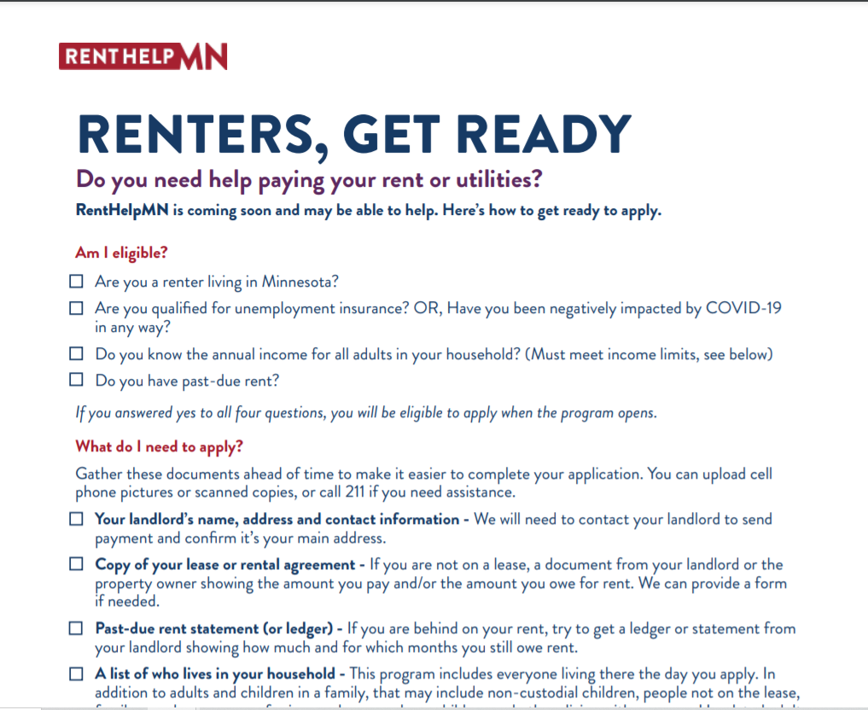
Step 1: The Renters' Checklist
Two Page Checklist/Quick Info Sheet
  Read before applying
  Available on renthelpmn.org

Slide 11
Step 2: Prescreening
What is Prescreening?
  Three Short Questions
  At the end – you can register an email address with RentHelpMN
  Completing Prescreening Prequalifies you for RentHelpMN, but is NOT a "pending application"

Slide 12
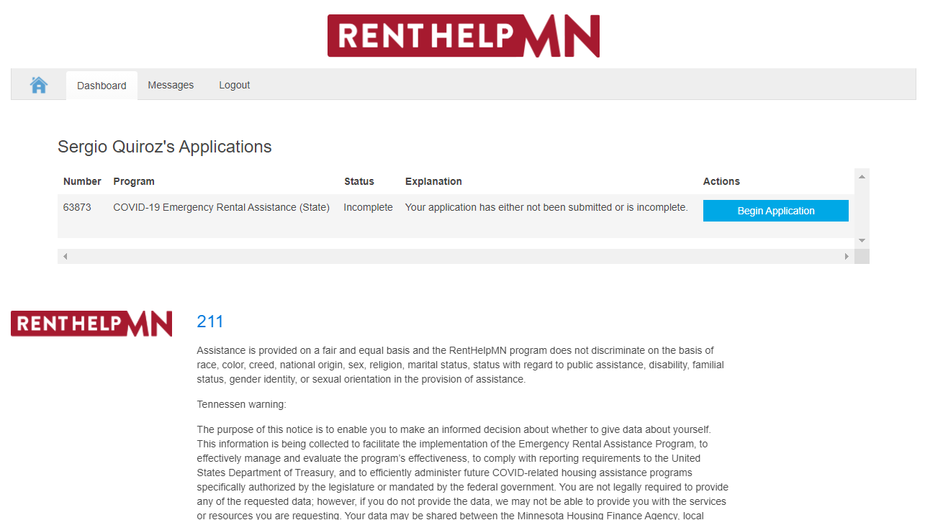

Step 3: The Rental Application

Slide 13
Step 3: The Rental Application
Steps in Application (Simplified
  Step 1: Applicant Info
  Step 2: Input Requested Assistance (Rent and/or Utilities, Amount of $ requested, and which months requested)
  Step 3: Income Information
  Step 4: Upload documents and submit.

Slide 14
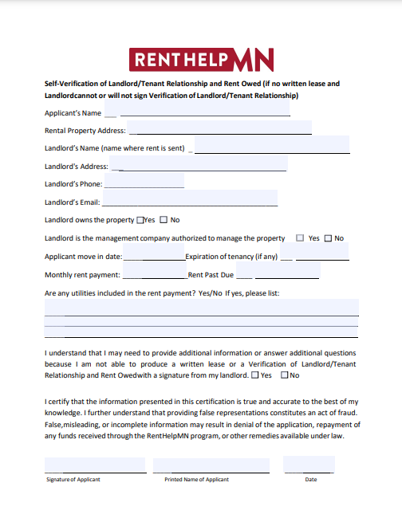
Self-Verification Form
Print out a bunch of these ahead of time if you are going to run into a bunch of clients.
Only use if Document submission is unavailable/impracticable

Slide 15
Types of Self-Certification
Non-exhaustive List of Things you can Self-Certify
  Rent Statement/Ledger
  Rental Agreement
  No Income
  ID

Slide 16
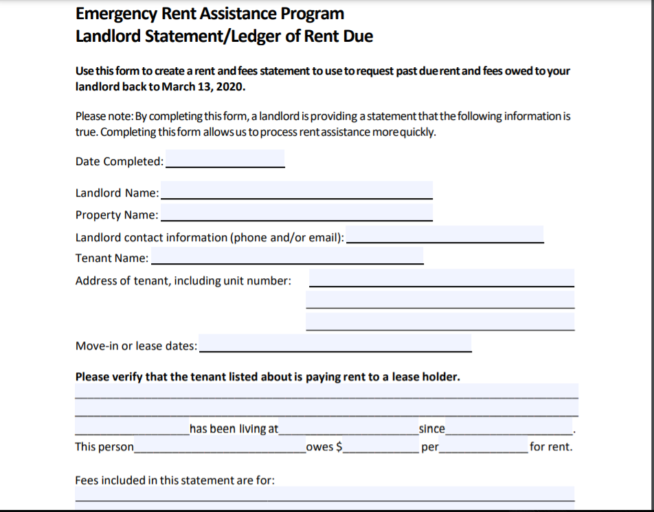
Rent Statement/Ledger Self-Cert Pt. 1

Slide 17
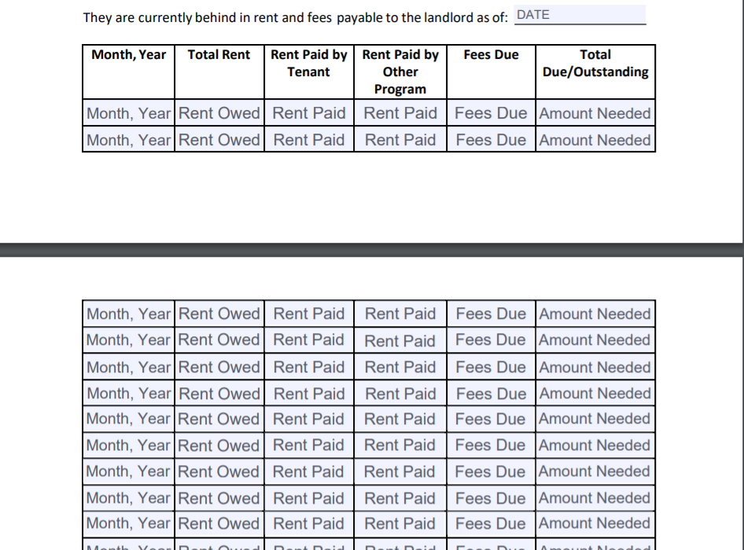
Rent Statement/Ledger Self-Cert Pt. 2

Slide 18

Pre-Qualification Letter

Slide 19
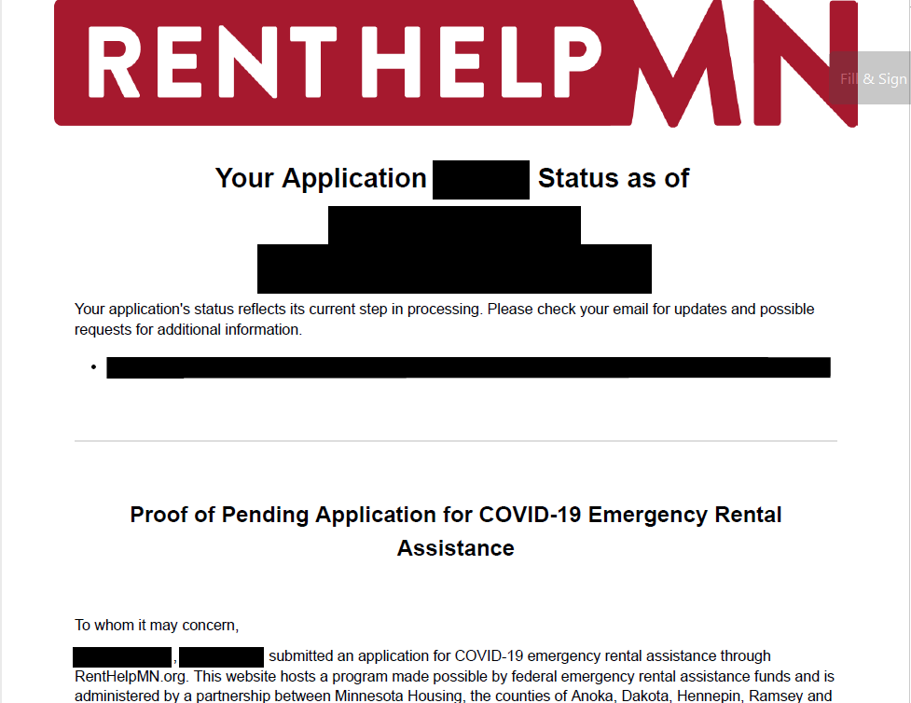




Slide 20
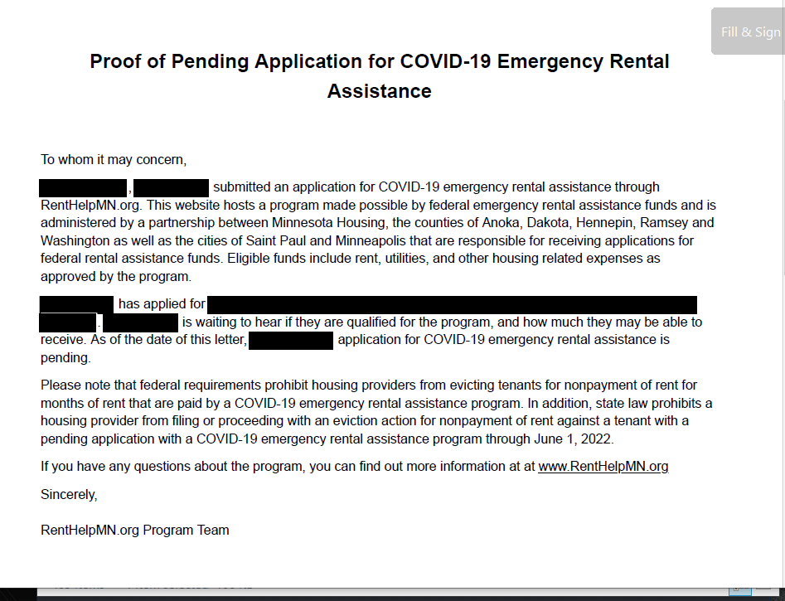







Slide 21
How does Eviction Off-Ramp affect RentHelpMN?
The Eviction Off-Ramp
  June 30, 2021 – Landlords can give lease termination or nonrenewal notices for material lease violations (NOT for nonpayment of rent).
  July 14 – Evictions ONLY for material violations of leases (excludes non-payment of rent)
  August 13 – Leases can be Terminated for Non-payment of rent, but only for those who are not eligible for COVID-19 rental assistance
  September 12 – Evictions for Non-payment of rent, but only for those who are not eligible for COVID-19 rental assistance
  October 12 – All lease terminations or evictions allowed BUT not for those with pending COVID-19 rental assistance applications
  June 1, 2022 – End of ALL COVID-19 renter protections

Slide 22
What if I was denied?
Option 1: Appeal
Option 2: Reapply
  Reapply through the online portal. Will automatically appear if available to the initially denied applicant.
  Should not have to wait 30 days if Reapply option is available

Slide 23
What if I was denied?
Option 1: Appeal
  By mail or by fax
  Must be done within 10 days
  No specific form – a letter will do
    State the following in the letter:
      Who you are; Name, Address, Application ID # (if known)
      Why you were denied (if known)
        Why this denial was in error
      Why you should be eligible

Slide 24
What if I was denied?
Important Things to Know
  “You should have received a written denial letter” – assume there will be no written denial letter
    Same for “denial letter” referenced in “declined by program” status.
  “Within 10 days” – to be safe, submit within 10 days of when you see the status changed to “denied by program”
  “Pending Appeal” is a pending application status under the off-ramp
    Eligible for protections like any other off-ramp status.
  There will likely be lag between an appeal sent and that status reflected in the dashboard/applicant status
    Status is not updated until appeal received and manually changed by processor.

Slide 25
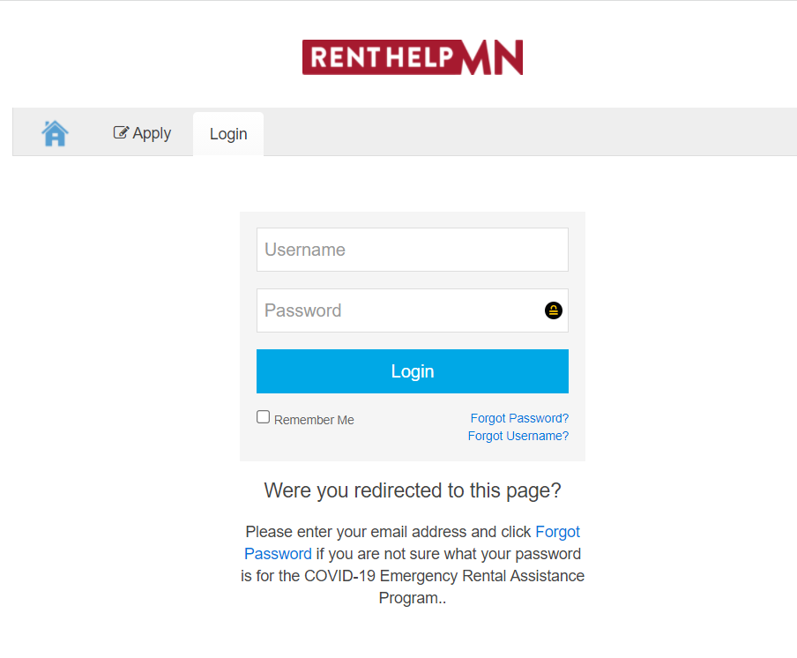
What if I Applied, But Forgot My Username/Password?
Username/Password Recovery
  Go to apply.renthelpmn.org/login
  You will need the email and/or the phone number that was used on the application

Slide 26
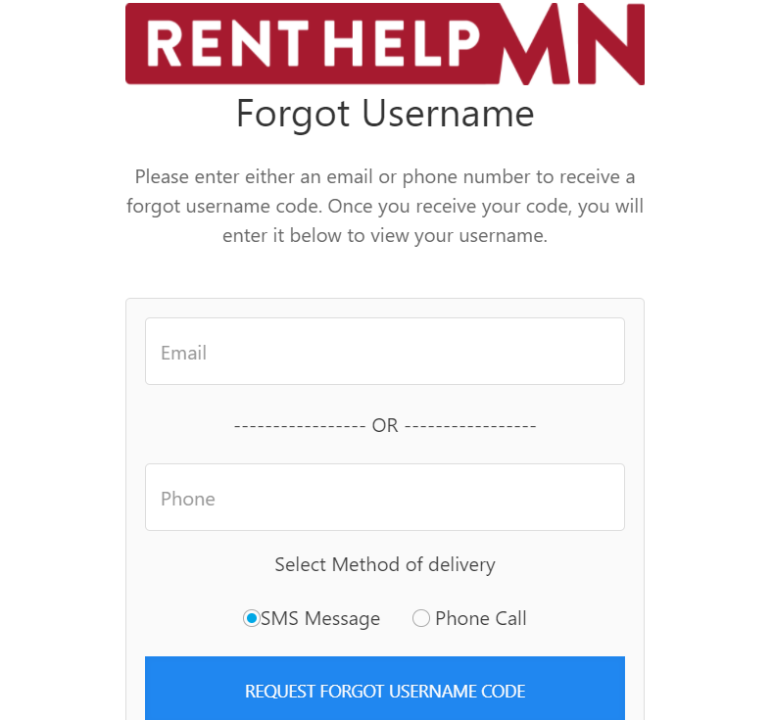

Forgot Username

Slide 27
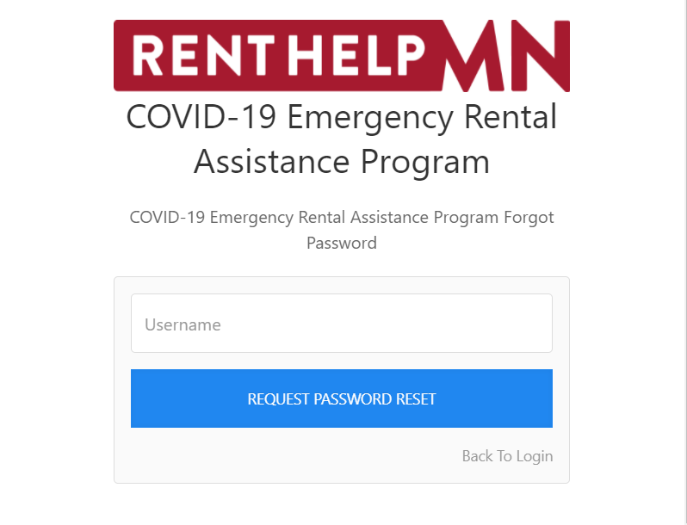

Forgot Password
NOTE: New password must be min. 15 characters

Slide 28
Frequently Asked Questions
Does my landlord have to participate in the RentHelpMN process?
  No, but landlord non-participation may slow down the application. However, in the event of landlord non-participation, money will be paid directly to the tenant instead of the landlord.
What if I have moved or plan to move before I would be approved for RentHelpMN?
  Previously, if you have moved or if you move before receiving rental funds your application will be deemed ineligible.
  Now – you are still eligible for payments – TBD on the process, in most cases payments will be delayed.

Slide 29
Frequently Asked Questions
How do I check the status of my application?
  Check your portal (regularly, if possible!), or call 211.
  TBD; general information available via database search
  Sometimes email notification for communications
What if I don’t owe rent right now, but I’m worried about future months?
  RentHelpMN is currently in Phase 1, so you need to owe rent from previous months to be eligible for assistance right now.
  When RentHelpMN moves to Phase 2 (date has not yet been announced), you can apply for help with future rent if your rent is not past due.

Slide 30
Frequently Asked Questions
How many months of assistance can I ask for?
  Maximum of 15 mo. right now.
  At some point (TBD), 18 mo. total.
Can my Landlord Evict Me After I Receive Assistance?
  Landlords cannot evict during the period of time covered by Rental Assistance
  Landlords can evict when covered period ends – there is no waiting period (beyond normal notice + additional off-ramp notice requirements)

Slide 31
Frequently Asked Questions
Does the Landlord or Tenant get a Letter when they Reach "Funding approved"?
  No – In fact, funding approved can still be changed to a pending status if something happens during review
  The only "final status" is payment sent.

Slide 32
Thank you!
Contact Us
General Inquiries: (612) 807-1139 or info@hjcmn.org
RentHelpMN Issues: 1 (800) 403-0476

Slide 33
Questions?

