Slide 1
The End of RentHelpMN and the Remainder of the Eviction Off-Ramp
(Feb. 2022)
Presented by Housing Justice Center

Slide 2
Who are we?
Housing Justice Center is a nonprofit public interest advocacy and legal organization whose mission is to preserve, protect, and expand affordable housing for low-income individuals and families.
We believe that housing is a human right, and we use tools such as legal advocacy, policy advocacy, education and research to bolster community-articulated strategies for housing justice.
Contact Us
General Inquiries: (612) 807-1139 or info@hjcmn.org

Slide 3
Today's Presenters: Max Tsai & Shana Tomenes
Contact Us
RentHelpMN related issues: (612) 807-1139
Email: mtsai@hjcmn.org

Slide 4
Agenda
End of RentHelpMN Overview
How do I check the Status of My Application? Username/Password Recovery
Prequalification Letter/Application Statuses
Common Remaining Documents
Appeals/What to do After Denial
FAQ
Q&A

Slide 5
RentHelpMN Basics – You must have been eligible at time of application to receive assistance
What is RentHelpMN?
  COVID-19 Emergency Rental Assistance Program distributed by Minnesota Housing
Who was eligible to apply?
  Low-income Minnesota renters
  Who were eligible for unemployment benefits OR had experienced financial hardship directly or indirectly due to the coronavirus outbreak
  Who could demonstrate a risk of experiencing homelessness or housing instability

Slide 6
RentHelpMN Basics Cont.
What is low-income for RentHelpMN?
  Renters must be at or below 80% of Area Median Income
  Ramsey County AMI
    1 Person Household - $55,950
    2 Person Household – $63,950
    3 Person Household - $71,950
    4 Person Household - $79,900
Documentation for Income Certification
  Form of ID for head of household – Must also document that they rent
  Documentation of household income for all adults – Tax and pay documents, employer certification.
  Most things can be self-certified to if documents are not available

Slide 7
RentHelpMN Basics Cont.
What types of rental properties are eligible for assistance?
  Apartments
  Single-family homes
  Rented manufactured homes
  Hotels, motel stays if they are the renter’s primary residence
  Other informal lease agreements subject to review by the program
What costs will be covered?
  Assistance for up to 18 months (18 mo. Rent AND/OR 18 mo. Utilities)
  Costs were only covered IF YOU HAD BACK RENT AT TIME OF APPLICATION – utility costs (minus phone or internet) + up to 3 months of forward rent. Late fees are covered as well.

Slide 8
How do I Check the Status of My Application?
Ways to Check Status
  1. Call 211
    Ask to have your application connected to a field partner.
  2. Log into your dashboard
  3. (if landlord) email landlords@renthelpmn.org
  4. (if application connected) – ask a field partner for a status update.

Slide 9
What if I Applied, But Don’t Know My Username/Password?
Reasons to use the Username/Password Recovery
  1. I applied online, but forgot my username/password
  2. I applied over the phone, and somebody filled in my application for me online, but I forgot or did not write down my username/password
  3. I applied using a paper application
    If you apply using a paper application, an online application will be created for you.

Slide 10
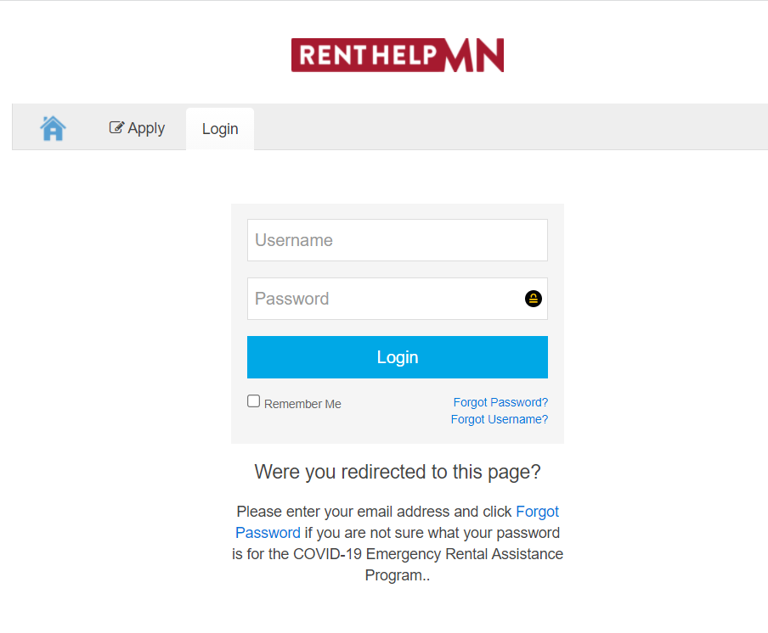
What if I Applied, But Don’t Know My Username/Password?
Username/Password Recovery
  Go to apply.renthelpmn.org/login
  You will need the email and/or the phone number that was used on the application

Slide 11
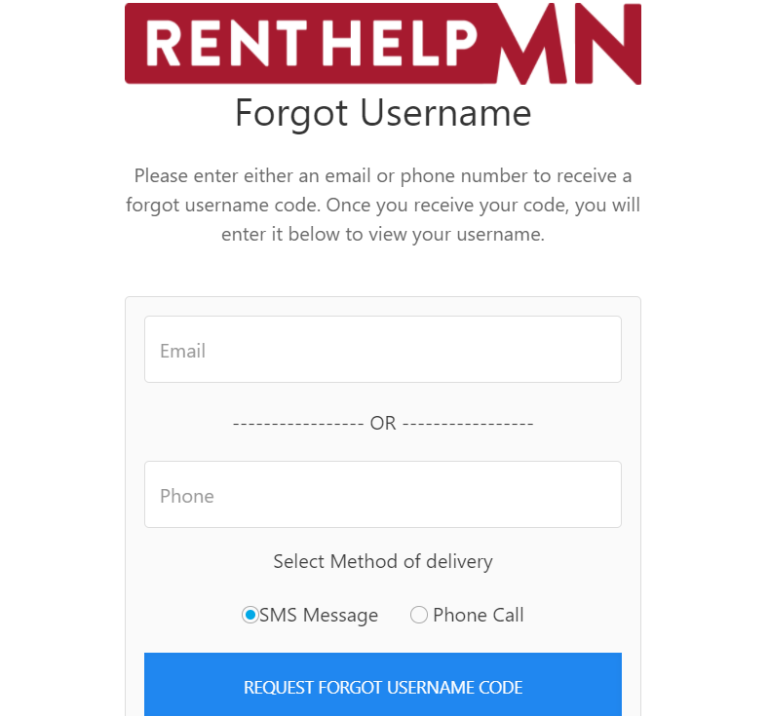

Forgot Username

Slide 12
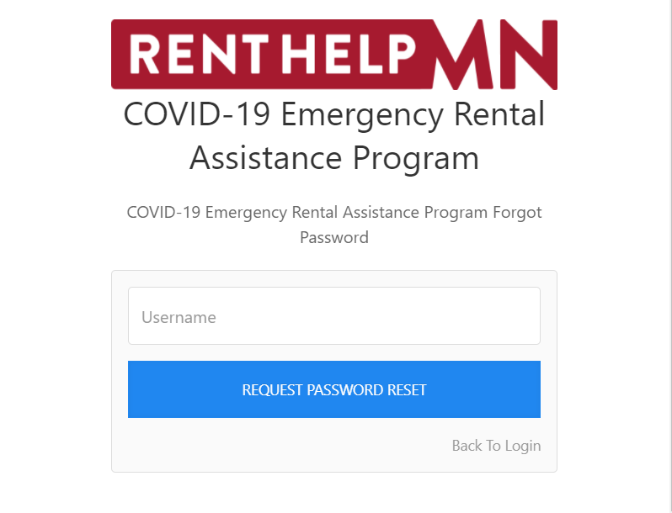

Forgot Password
NOTE: New password must be min. 15 characters

Slide 13
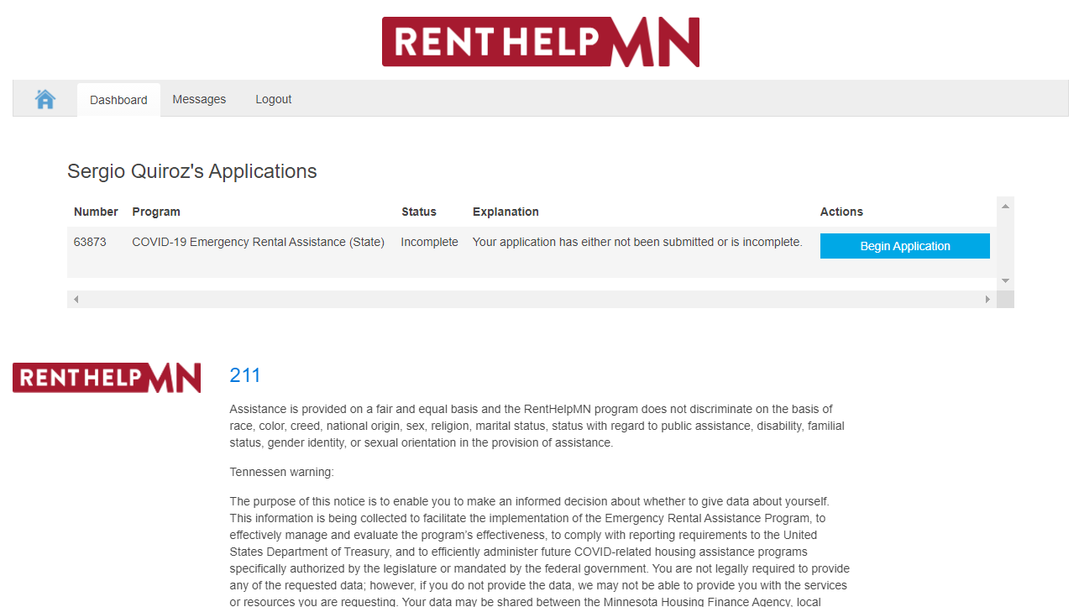


The Renter Dashboard

Slide 14
What is a Pending Status?
A Pending Status is a Status Still Being Processed by MN Housing
  (Non-Exhaustive) Examples of pending statuses;
    Pending Initial Review
    Requires Applicant Response
    Declined by Landlord
    Appeal Pending
    Final Review
  (Non-Exhaustive) Examples of NOT pending Statuses
    Declined by Program
    Declined by Renter
    Withdrawn

Slide 15
Common Requested Documents
Common Documents Requested
  Rent Ledger
  Rental Agreement
    Household Change Sometimes Required if Lease is Different than Current Situation
  Utility Bill
  Self-Verification Forms Available at renthelpmn.org/resources

Slide 16
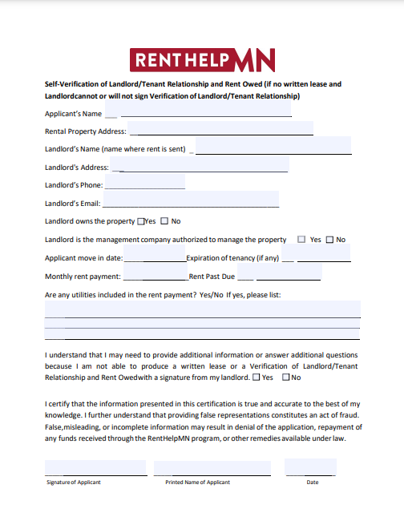
Self-Verification Form
Print out a bunch of these ahead of time if you are going to run into a bunch of clients.
Only use if Document submission is unavailable/impracticable

Slide 17
Types of Self-Certification
Non-exhaustive List of Things you can Self-Certify
  Rent Statement/Ledger
  Rental Agreement
  No Income
  ID
  Household Change (if current household different from household on the lease)

Slide 18
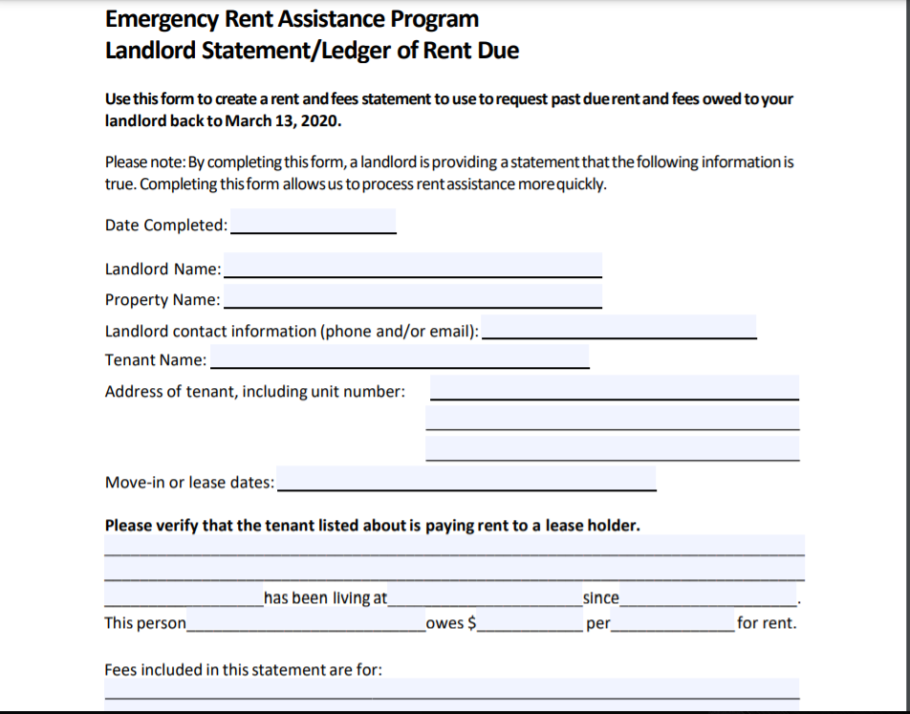
Rent Statement/Ledger Self-Cert Pt. 1

Slide 19
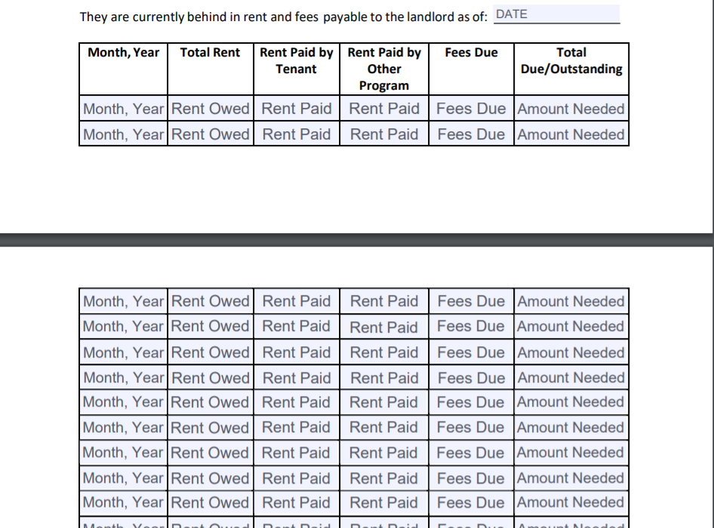
Rent Statement/Ledger Self-Cert Pt. 2

Slide 20
Pre-Qualification Letter

Slide 21
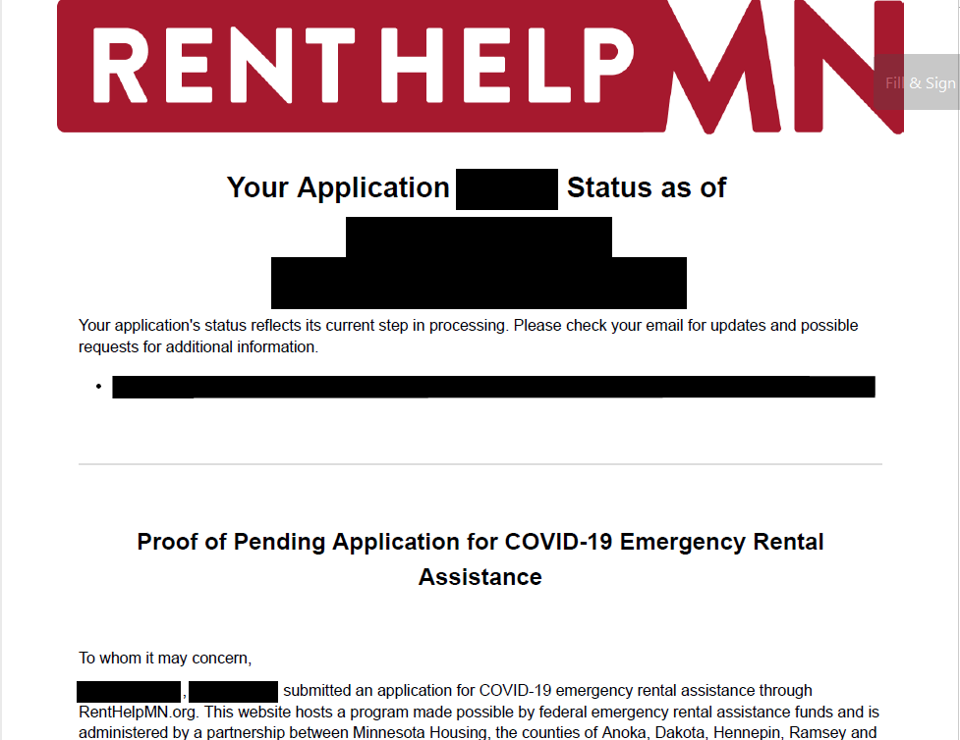




Slide 22
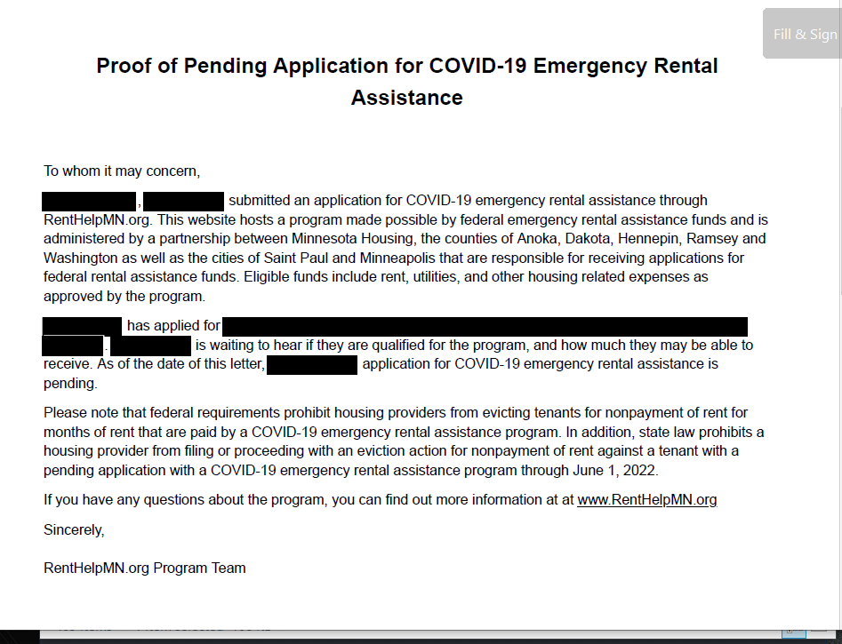







Slide 23
Eviction Off-Ramp & RentHelpMN Protections
The Eviction Off-Ramp
  Final protections end on June 1, 2022
    Protects Minnesotans from nonpayment of rent eviction who have a pending application for RentHelpMN
    Landlords can check on their landlord portal to see if tenant has applied for RentHelpMN
    Tenants who get an eviction notice while having a pending RentHelpMN application should communicate that to their landlord AND attend court

Slide 24
What if I was denied?
Most denials come via email – make sure to check email consistently
Most common reasons for denial
  Lack of communication
  Incomplete documents

Slide 25
How to Appeal a RentHelpMN denial
Appeal can only be done by mail or by fax
  Instructions & required cover letter forms can be found on renthelpmn.org/resources
  Appeal must be sent within 10 days
  No specific form – a letter will do
    State the following in the letter:
      Who you are; Name, Address, Application ID # (if known)
      Why you were denied (if known)
      Why this denial was in error
      Why you should be eligible
  What to include
    Letter
    Cover page
    Documents (if applicable)

Slide 26
What if I was denied?
Important Things to Know
  “Within 10 days” – to be safe, submit within 10 days of when you see the status changed to “denied by program” (but should be from when an email or letter is sent).
    If you receive letter or email at a later point, you can argue for 10 days after receipt of that letter if you miss the initial 10 day window.
  “Pending Appeal” is a pending application status under the off-ramp
    Eligible for protections like any other off-ramp status.
  There will likely be lag between an appeal sent and that status reflected in the dashboard/applicant status
    Status is not updated until appeal received and manually changed by processor. Keep a copy of what you sent as proof of appeal.

Slide 27
Who can help me file a RentHelpMN appeal?
Appeals can be confusing. It never hurts to reach out to get answers to your questions!
  Contact your field partner if you worked with a field partner to complete your application
  Call 2-1-1 to be connected with a field partner who can help you navigate the appeals process
  Call the Housing Justice Center – 612-807-1139
  The timeline to file an appeal is short--make sure to reach out as early as possible to get answers to your questions and help completing your appeal.

Slide 28
Frequently Asked Questions
I applied by the deadline. Will RentHelpMN run out of money before my application is processed?
That is unlikely. Based on current communication from Minnesota Housing it is unlikely that the program will run out of money and will be able to process and pay all of the applications that are pending.
Does my landlord have to participate in the RentHelpMN process?
  No, but landlord non-participation may slow down the application. However, in the event of landlord non-participation, money will be paid directly to the tenant instead of the landlord.
What if I have moved or plan to move before I would be approved for RentHelpMN?
  Your application will be denied, and you will not have the opportunity to reapply.

Slide 29
Frequently Asked Questions
How many months of assistance can I ask for?
  18 Months of utilities AND/OR rent.
Can my Landlord Evict Me After I Receive Assistance?
  Landlords cannot evict tenants for non-payment of rent while a rental assistance application is pending (i.e. not denied OR paid out)
  Can still be evicted for other material breach reasons

Slide 30
Frequently Asked Questions
How do I check the status of my application?
  Check your portal (regularly, if possible!), or call 211.
  Sometimes email notification for communications
  Sometimes case managers will call you
Does the Landlord or Tenant get a Letter when they Reach "Funding approved"?
  No – but should receive confirmation after payment is sent
  Payment letter should show breakdown of months requested and amount of payment for each month of assistance.

Slide 31
Thank you!
Contact Us!
(612) 807-1139
info@hjcmn.org

Slide 32
Questions?

